Slide 1

The Ups and Downs of Investing in the Stock Market: A Comprehensive Guide
Exploring strategies, risks, and market trends
Notes:
AI-generated content may be incorrect. --- Investing in the stock market can be both exhilarating and daunting. This presentation will provide a thorough overview of the stock market, its benefits and risks, effective investment strategies, notable historical events, and future trends.

Slide 2

Outline of Topics
Introduction to the Stock Market
Benefits of Investing in the Stock Market
Risks and Challenges of Stock Market Investing
Strategies for Successful Investing
Case Studies of Notable Market Ups and Downs
Future Trends and Considerations
Notes:
In this presentation, we will explore the stock market's fundamentals, including its history, key players, and components. We will then discuss the benefits of investing, along with the risks and challenges investors face. Next, we'll delve into effective investment strategies and examine notable market events. Finally, we'll look at future trends influencing stock market investments.

Slide 3
Introduction to the Stock Market
Notes:
Understanding the stock market is crucial for any investor. It serves as a platform where shares of publicly traded companies are bought and sold, reflecting the economy's health and investor sentiment.

Slide 4

What Is the Stock Market?
Definition of Stock Market
The stock market consists of various markets where shares of publicly traded companies are bought and sold, facilitating capital movement.
Capital Raising for Companies
Companies raise capital by issuing shares in the stock market, allowing for expansion and growth opportunities.
Ownership for Investors
Investors can buy shares to gain ownership in companies, leading to potential profits from dividends and capital appreciation.
Notes:
The stock market is a collection of markets where shares of publicly held companies are traded. It helps companies raise capital by selling shares and allows investors to buy ownership in these companies.

Slide 5

History and Evolution of Stock Markets
Inception in the 1600s
The stock market began in the 1600s, primarily as a means for companies to raise capital through share issuance.
Transition to Global Marketplace
Over the centuries, the stock market has transformed into a complex global marketplace for trading securities influenced by various factors.
Influence of Technology
Advancements in technology have revolutionized trading practices, making transactions faster and more accessible worldwide.
Regulatory Changes
Regulation has played a critical role in shaping stock markets to ensure fair trading and protect investors.
Notes:
The stock market has evolved significantly since its inception in the 1600s. It has transitioned from a simple exchange of shares to a complex global marketplace influenced by technology and regulation.

Slide 6

Key Players and Components
Market Participants
The stock market consists of individual and institutional investors, brokers, and market makers, each playing a crucial role.
Stock Exchanges
Stock exchanges are platforms where securities are bought and sold, vital for the functioning of the market.
Regulatory Bodies
Regulatory bodies ensure fair practices and protect investors by enforcing rules and regulations within the market.
Notes:
The stock market comprises various players, including individual investors, institutional investors, brokers, and market makers. Key components include stock exchanges, indices, and regulatory bodies that ensure fair practices.

Slide 7
Benefits of Investing in the Stock Market
Notes:
Investing in the stock market offers numerous advantages. Understanding these benefits helps investors make informed decisions to grow their wealth effectively.

Slide 8

Potential for High Returns
High Returns Potential
Investing in stocks offers the potential for significantly high returns, especially over the long term.
Equities vs. Other Assets
Historically, equities have outperformed various other asset classes, making them a preferred investment choice.
Notes:
One of the primary advantages of investing in stocks is the potential for high returns over the long term. Historically, equities have outperformed other asset classes, making them an attractive investment option.

Slide 9
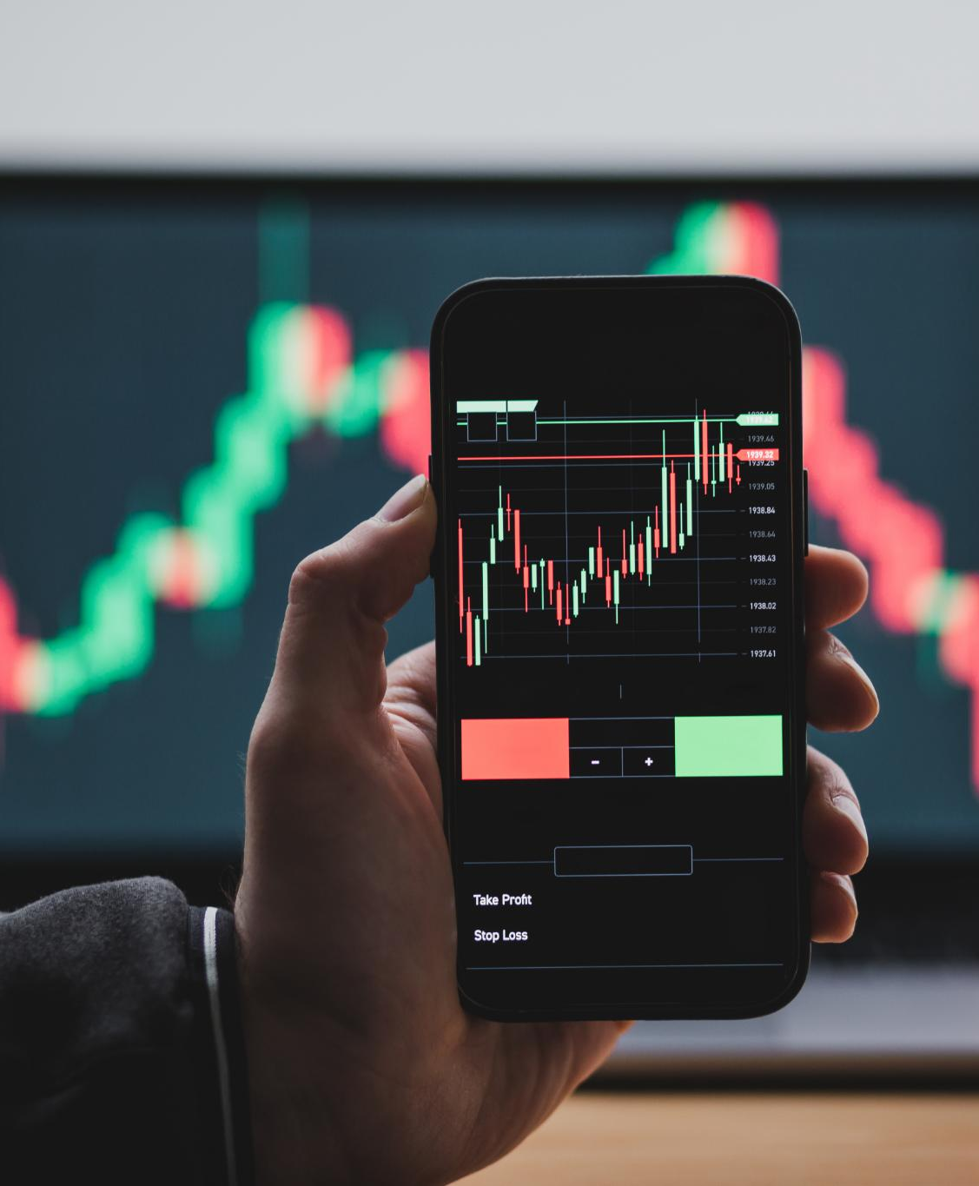
Liquidity and Accessibility
High Liquidity
The stock market offers high liquidity, enabling investors to quickly buy and sell shares as needed.
Technological Advancements
Advancements in technology have transformed the investing landscape, making it easier for individuals to participate in the stock market.
Global Accessibility
Investing is now accessible to people worldwide, allowing a broader range of individuals to engage in the financial markets.
Notes:
The stock market provides high liquidity, allowing investors to buy and sell shares quickly. Additionally, with advancements in technology, investing has become more accessible to people worldwide through online trading platforms.

Slide 10

Portfolio Diversification
Risk Mitigation
Diversifying investments can significantly reduce risks associated with market volatility and sector-specific downturns.
Sector Diversification
Investing across different sectors can protect against poor performance in any single sector.
Asset Class Variety
Including different asset classes like stocks, bonds, and real estate can enhance portfolio stability and growth potential.
Notes:
Investing in diverse stocks can help mitigate risks. By spreading investments across various sectors and asset classes, investors can reduce the impact of underperforming stocks on their overall portfolio.

Slide 11
Risks and Challenges of Stock Market Investing
Notes:
While the stock market offers potential rewards, it also comes with risks and challenges. Understanding these factors is essential for effective risk management.

Slide 12

Market Volatility
Understanding Market Volatility
Market volatility represents the extent of price fluctuations in the stock market over a specific period.
Causes of Volatility
Economic indicators, interest rates, and geopolitical events are major factors that contribute to market volatility.
Risks to Investors
High market volatility can pose significant risks to investors, impacting their investment strategies and decisions.
Notes:
Market volatility refers to the fluctuations in stock prices. Factors such as economic indicators, interest rates, and geopolitical events can cause significant price swings, posing risks to investors.

Slide 13

Economic and Political Influences
Macroeconomic Factors
Macroeconomic factors like inflation and unemployment rates play a crucial role in influencing stock market trends.
Government Policies
Government policies can significantly affect investor confidence and stock market performance, driving investment strategies.
Political Events
Political events, such as elections and policy announcements, can create volatility in the stock market and affect investor behavior.
Notes:
The stock market is influenced by macroeconomic factors such as inflation, unemployment rates, and government policies. Political events can also impact investor confidence and market performance.

Slide 14
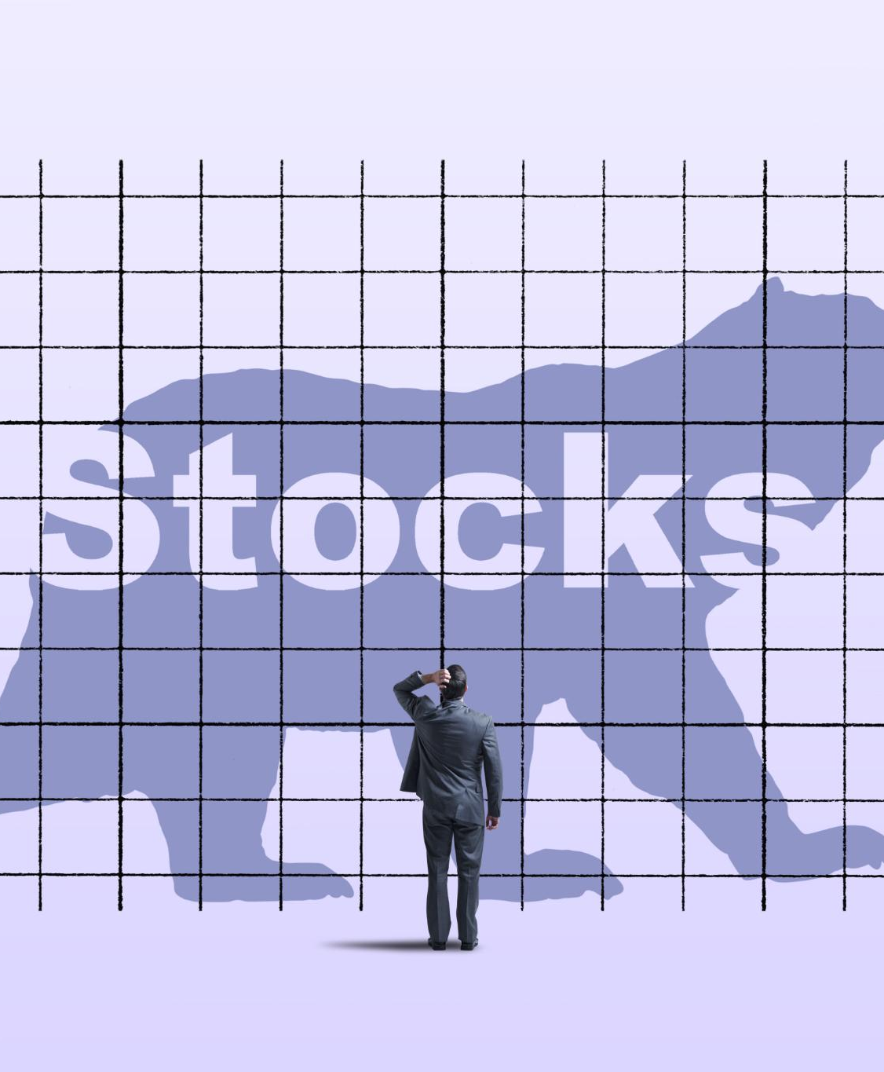
Emotional and Psychological Factors
Impact of Emotions
Investors' emotional responses can greatly influence their decisions, often leading to irrational choices in the market.
Fear in Investing
Fear can lead to panic selling and missed opportunities, negatively impacting investment strategies and outcomes.
Greed and Risk
Greed drives investors to take excessive risks, which can result in poor investment choices if not managed carefully.
Notes:
Investors' emotional responses can significantly affect their decision-making. Fear and greed often drive market behaviors, leading to poor investment choices if not managed properly.

Slide 15
Strategies for Successful Investing
Notes:
Adopting effective strategies can enhance investment outcomes. Investors must consider their goals, risk tolerance, and market conditions when developing their strategies.

Slide 16

Long-Term Vs. Short-Term Investing
Long-Term Investing
Long-term investing emphasizes growth over several years, allowing investments to compound and mitigate volatility.
Short-Term Investing
Short-term investing focuses on capitalizing on market fluctuations to achieve quick returns, often involving higher risk.
Risk-Reward Profiles
Each investment approach has distinct risk-reward profiles; longer commitments typically offer stability, while shorter ones can yield rapid gains or losses.
Notes:
Investors can choose between long-term strategies, which focus on growth over years, and short-term strategies that capitalize on market fluctuations. Each approach has its own risk–reward profile.

Slide 17

Fundamental and Technical Analysis
Fundamental Analysis
Fundamental analysis evaluates a company's financial health by examining its financial statements and growth potential, informing investment decisions.
Technical Analysis
Technical analysis focuses on price patterns and market trends, using historical data to predict future price movements in the stock market.
Notes:
Investors use fundamental analysis to evaluate a company's financial health and growth potential, while technical analysis focuses on price patterns and market trends to make trading decisions.

Slide 18

Risk Management and Diversification
Clear Investment Goals
Setting clear investment goals is crucial for effective risk management, helping to align strategies with desired outcomes.
Stop-Loss Orders
Using stop-loss orders can help mitigate losses by automatically selling an asset when it reaches a certain price.
Portfolio Diversification
Diversifying portfolios minimizes exposure to any single investment's risks, spreading the risk across various assets.
Notes:
Effective risk management involves setting clear investment goals, using stop-loss orders, and diversifying portfolios to minimize exposure to any single investment's risks.

Slide 19
Case Studies of Notable Market Ups and Downs
Notes:
Examining historical market events provides valuable insights into the factors that influence market movements and investor behavior during crises.

Slide 20

The Great Depression and Its Aftermath
Economic Downturn
The Great Depression marked a significant economic downturn, leading to severe declines in markets across the globe.
Widespread Unemployment
This period saw unprecedented levels of unemployment, affecting millions of families and communities.
Regulatory Changes
The aftermath of the Great Depression resulted in significant regulatory changes aimed at preventing future economic crises.
Notes:
The Great Depression (1929) was a catastrophic economic downturn that led to severe market declines, widespread unemployment, and significant regulatory changes in the stock market.

Slide 21

The Dot-Com Bubble
Excessive Speculation
The late 1990s experienced rampant speculation in technology stocks, driving prices to unsustainable levels.
Market Crash of 2000
In 2000, the bubble burst, resulting in a significant market crash and substantial financial losses.
Risks of Overvaluation
The dot-com bubble serves as a cautionary tale about the dangers of overvaluing technology stocks based on speculation.
Herd Behavior
The phenomenon of herd behavior greatly contributed to the bubble as investors followed trends without thorough analysis.
Notes:
In the late 1990s, the dot-com bubble saw excessive speculation in technology stocks, leading to a market crash in 2000. This case study highlights the risks of overvaluation and herd behavior.

Slide 22

The 2008 Financial Crisis and Recovery
Triggers of the Crisis
The crisis was primarily triggered by the collapse of the housing market coupled with the failure of mortgage-backed securities.
Risk Management Lessons
The crisis highlighted essential lessons in risk management that are crucial for preventing future financial disasters.
Regulatory Oversight Importance
The financial crisis underscored the critical need for regulatory oversight to maintain stability in financial markets.
Notes:
The 2008 financial crisis was triggered by the collapse of the housing market and mortgage-backed securities. It offers lessons in risk management and the importance of regulatory oversight in financial markets.

Slide 23
Future Trends and Considerations
Notes:
Looking ahead, several trends are shaping the future of investing in the stock market. Understanding these trends can help investors navigate the changing landscape.

Slide 24

Impact of Technology and Innovation
Revolutionizing Trading
Technological advancements are changing the way trading is conducted, making it faster and more efficient than ever.
Influence of AI
Artificial intelligence is increasingly influencing trading decisions, providing insights that were previously unattainable.
Algorithmic Trading
Algorithmic trading utilizes complex algorithms to execute trades at high speed, enhancing market efficiency.
Notes:
Technological advancements are revolutionizing trading, analysis, and data accessibility. Algorithmic trading and AI are becoming increasingly influential in the stock market.

Slide 25

Globalization and Market Interconnectivity
Impact of Global Events
Global events like economic shifts or political changes can significantly influence local markets and economies.
Investor Awareness
Investors must stay updated on international developments to make informed decisions regarding their investments.
Market Interconnectivity
The interconnectivity of markets requires a comprehensive understanding of how global dynamics affect local investments.
Notes:
As markets become more interconnected, global events can impact local markets. Investors need to stay informed about international developments and their potential effects on investments.

Slide 26

Sustainable and Ethical Investing
Definition of Ethical Investing
Ethical investing involves choosing companies that prioritize social responsibility, sustainability, and ethical practices in their operations.
Growing Investor Interest
The trend of sustainable investing is growing as more investors look to align their personal values with their financial choices.
Impact on Companies
Companies that adopt sustainable practices not only contribute positively to society but also enhance their market reputation and performance.
Notes:
Sustainable and ethical investing focuses on companies that prioritize social responsibility and environmental sustainability. This trend is gaining traction as investors seek to align their values with their investments.

Slide 27
Conclusion
Understanding Market Mechanics
A nuanced understanding of stock market mechanics is essential for successful investing and making informed decisions.
Benefits of Investing
Investing in the stock market can provide significant benefits, including potential wealth growth and portfolio diversification.
Risk Awareness
Understanding the risks associated with stock market investing is crucial for mitigating potential losses and enhancing success.
Effective Investment Strategies
Employing effective investment strategies and staying informed can significantly enhance investors' chances of success in the market.
Notes:
Investing in the stock market requires a nuanced understanding of its mechanics, benefits, and risks. By employing effective strategies and staying informed about market trends, investors can enhance their chances of success.

